Slide 1
Meeting Kaitlin and Pierre: Correlation Maps
Joren Janzing

Slide 2
Content
Method
What is the correct ‘box’ for winds to look at in the model? Correlation maps: - Zonal winds in space with timeseries of shelf temperatures - Zonal winds in space with timeseries of Dotson to Cosgrove melt % Shelf temperatures in space with timeseries of shelf break winds % Melt in space with timeseries of shelf break winds
First glance at CESM2
What wind conditions are common for warm periods? And what is different for the 1940s?

Slide 3
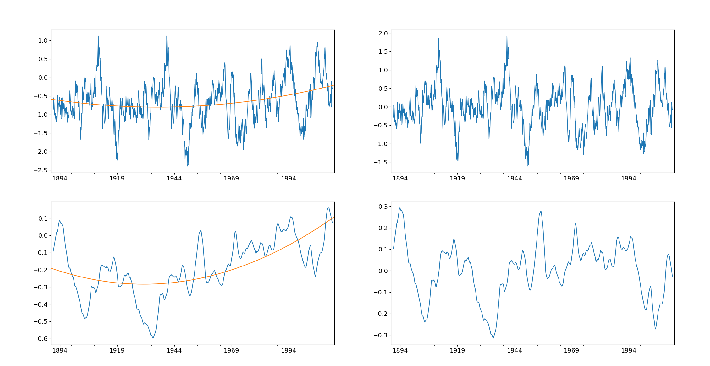
Method:
Quadratic detrending
Note: in the program I first start time series from 1920
Original
Detrended
Zonal Wind
Amundsen shelft Temp

Slide 4
Method
How to find the correct lag? (in a way that does not cost to much time..) → Now: find the lag between the precomputed time series and then look at few months around that. → Confirmation bias….
Mean wind vectors: now ensemble mean: not detrended!

Slide 5
What is the correct box to look at?

Slide 6
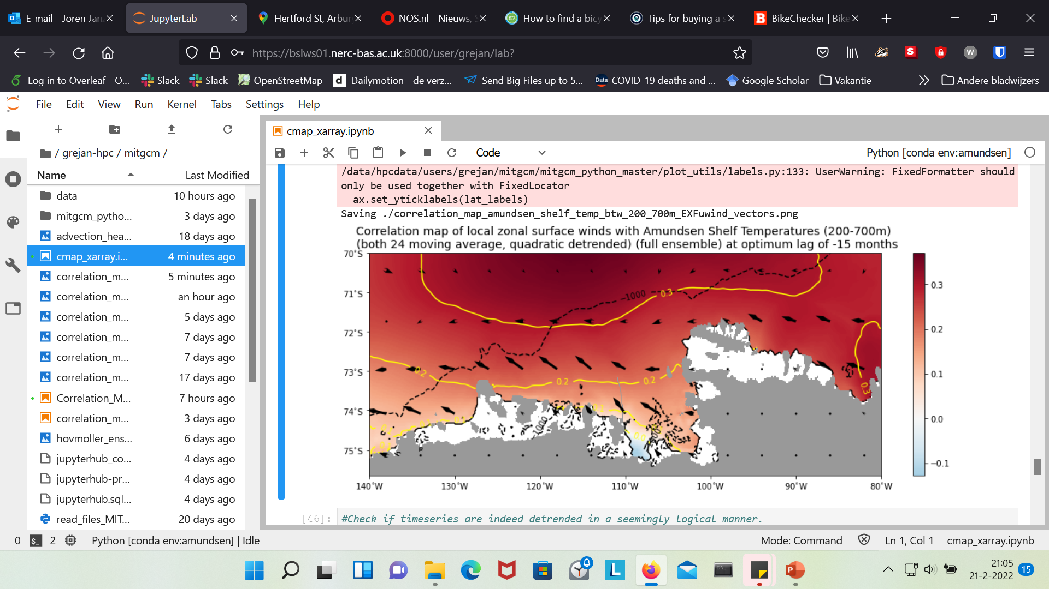
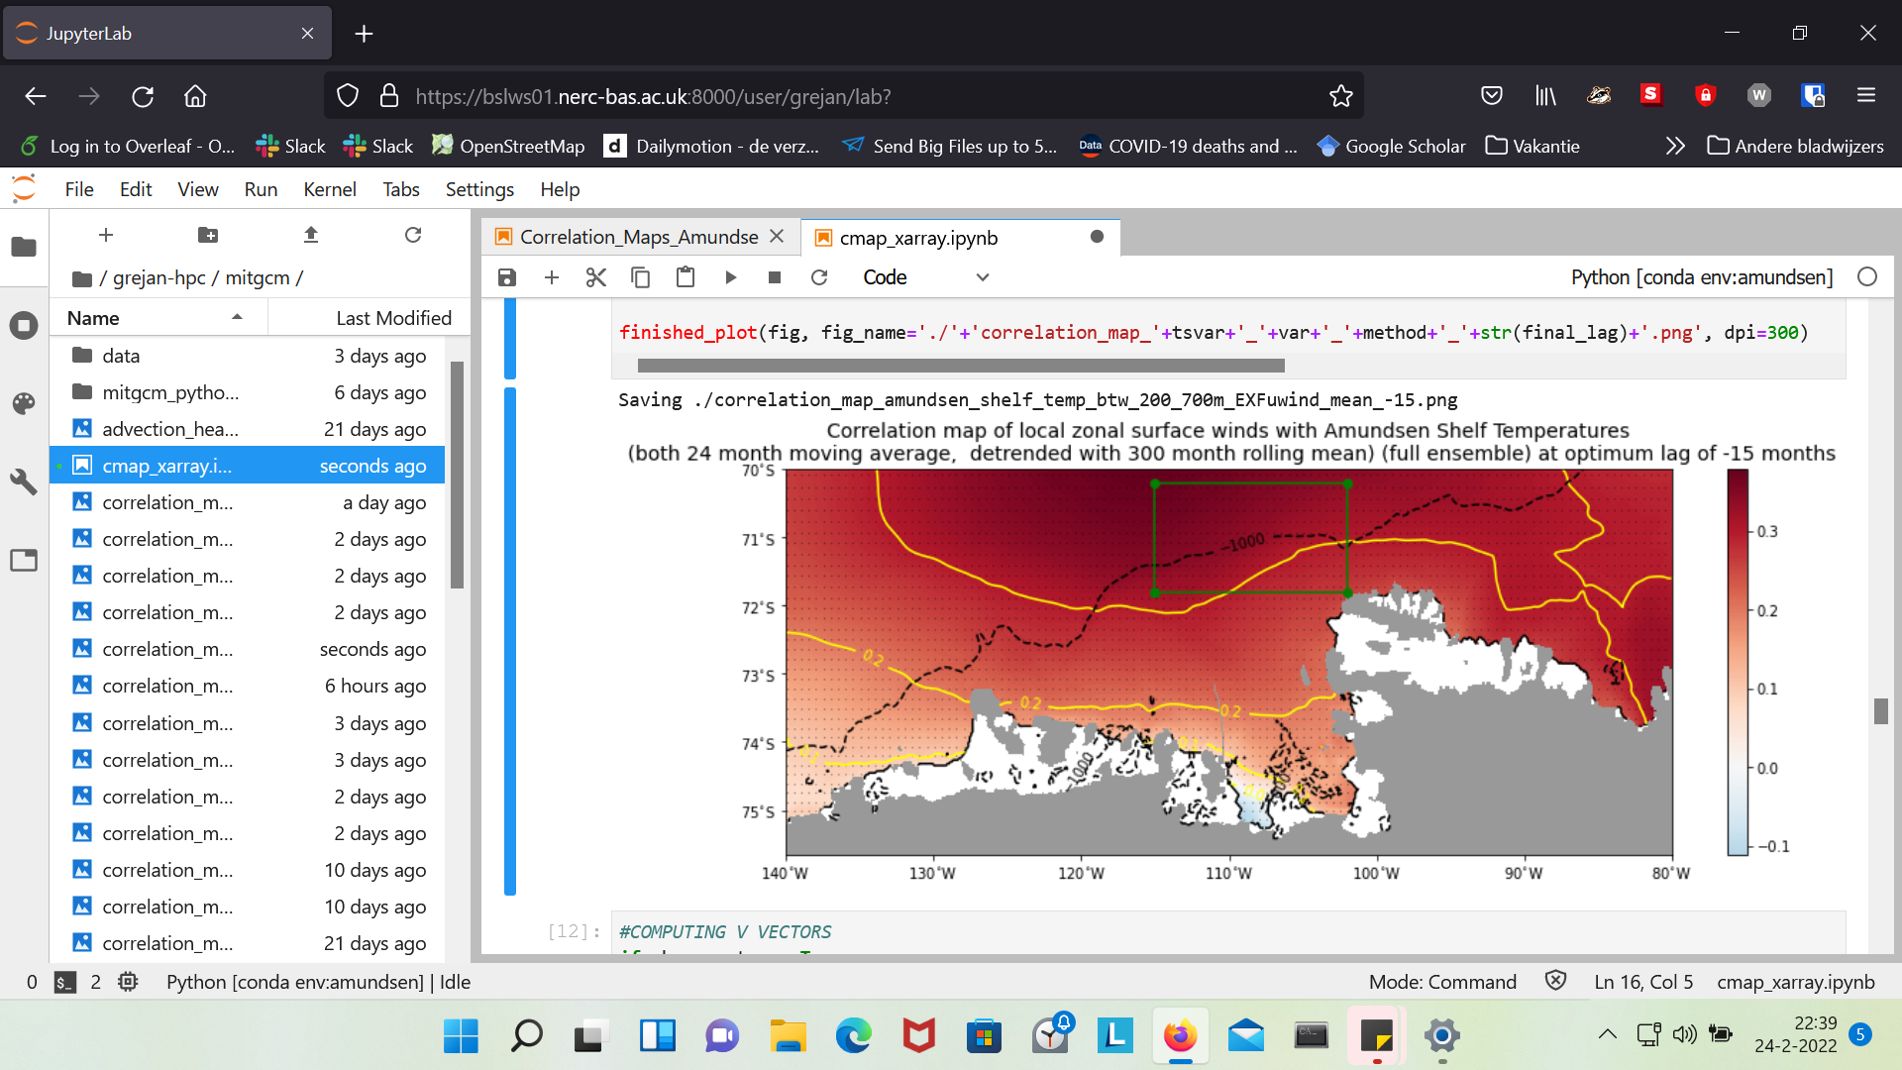
Is the lag here not way too long?

Slide 7
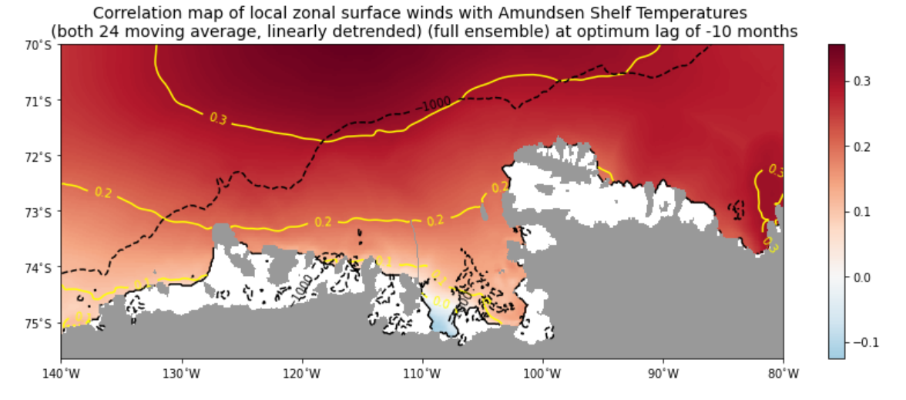
5

Slide 8
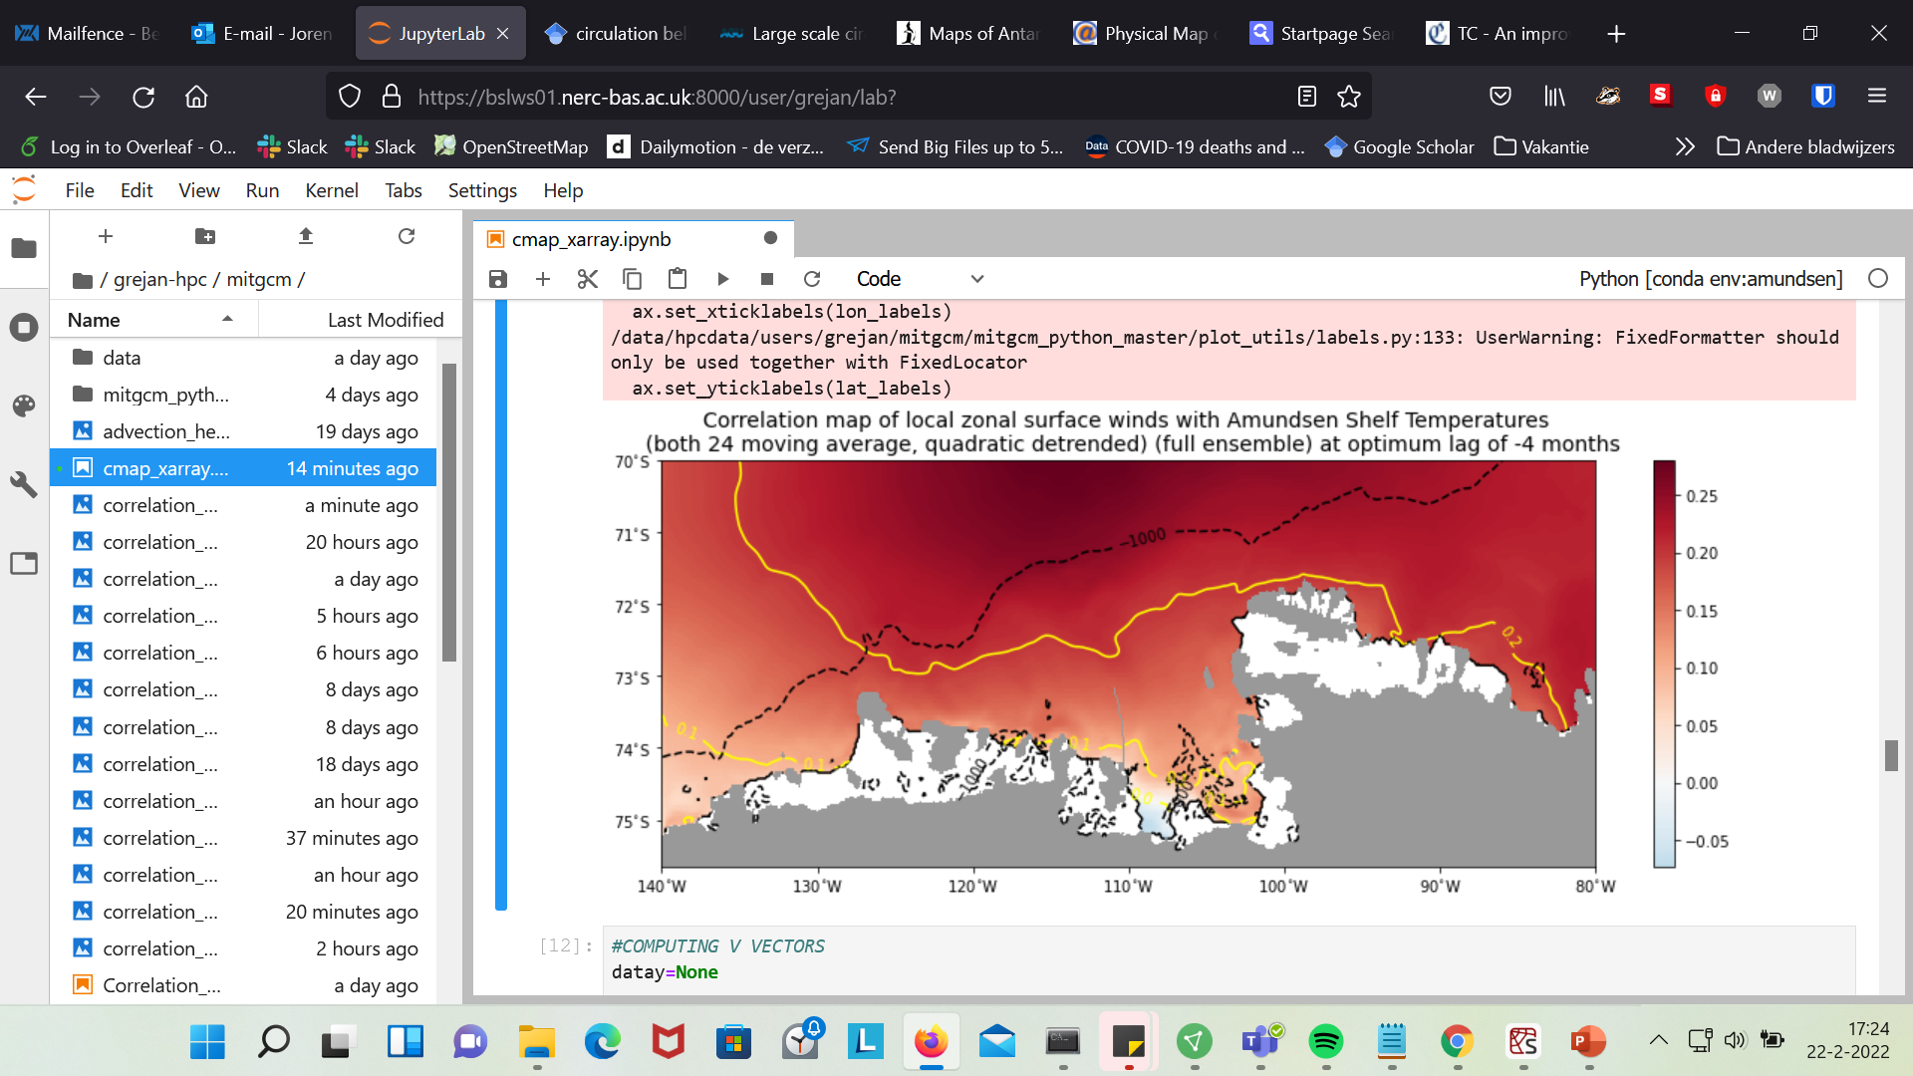
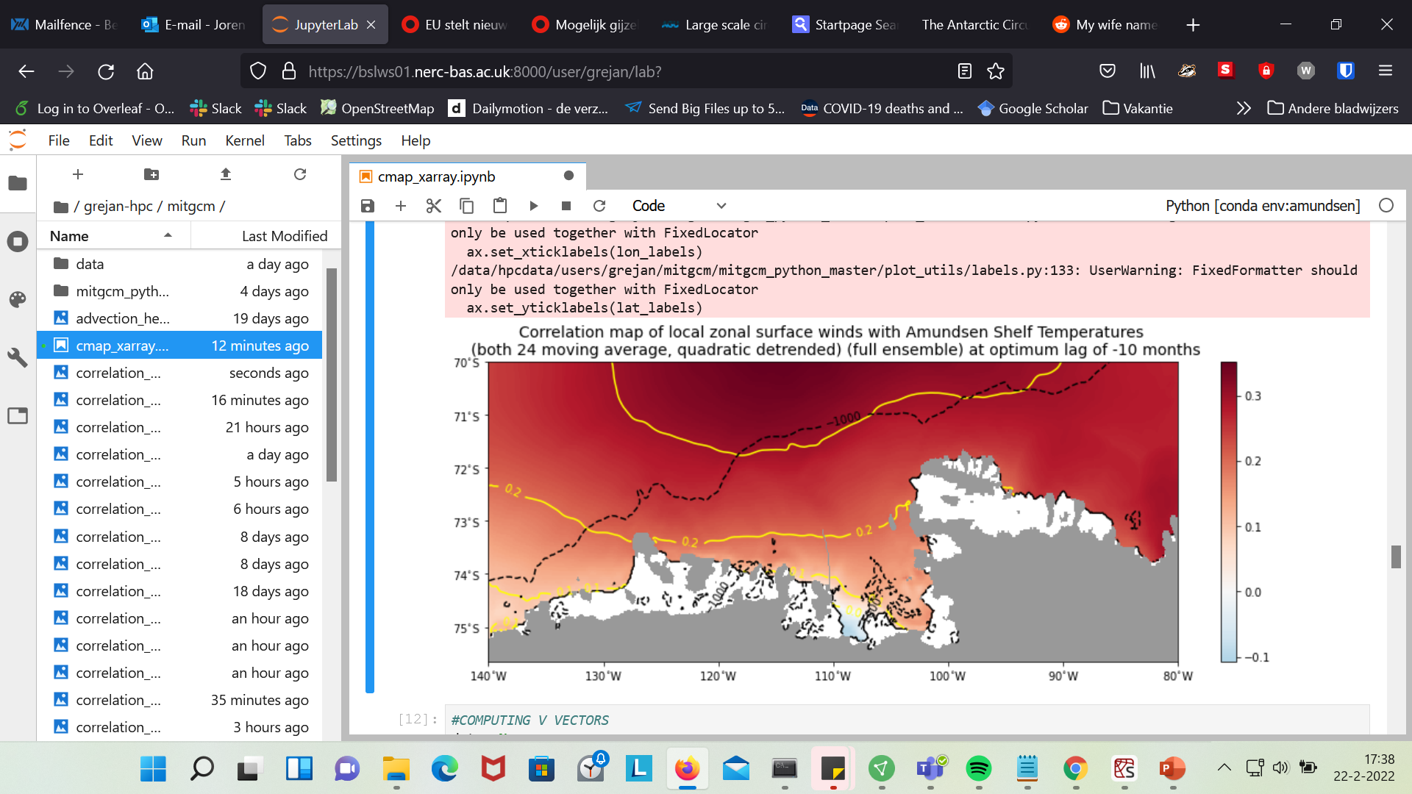

Slide 9
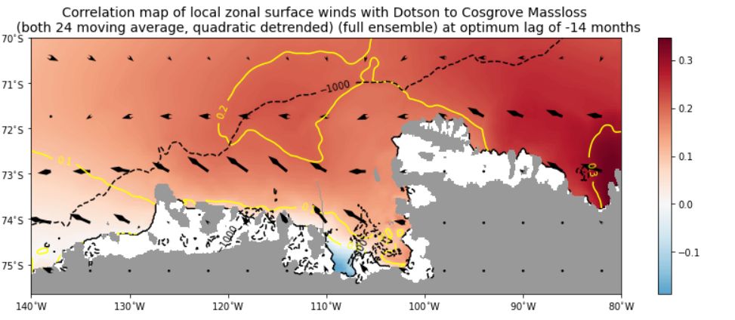

Slide 10
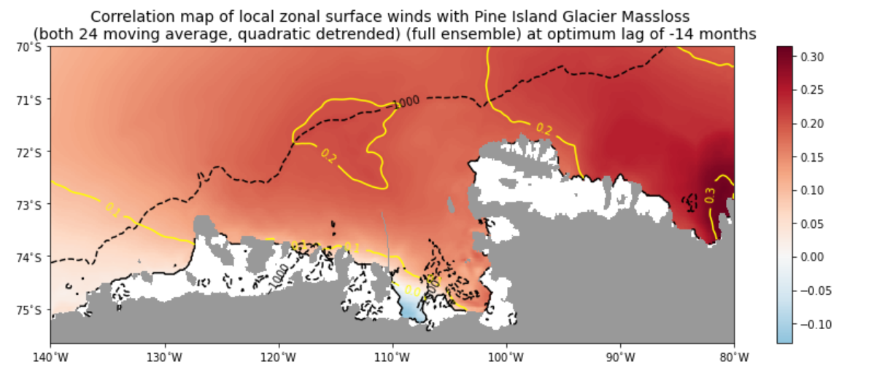

Slide 11
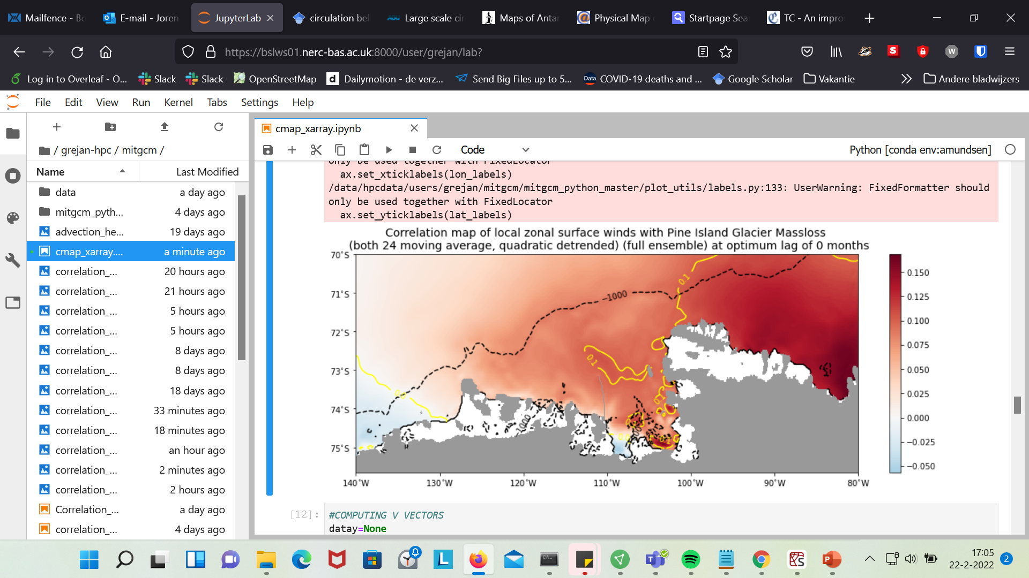
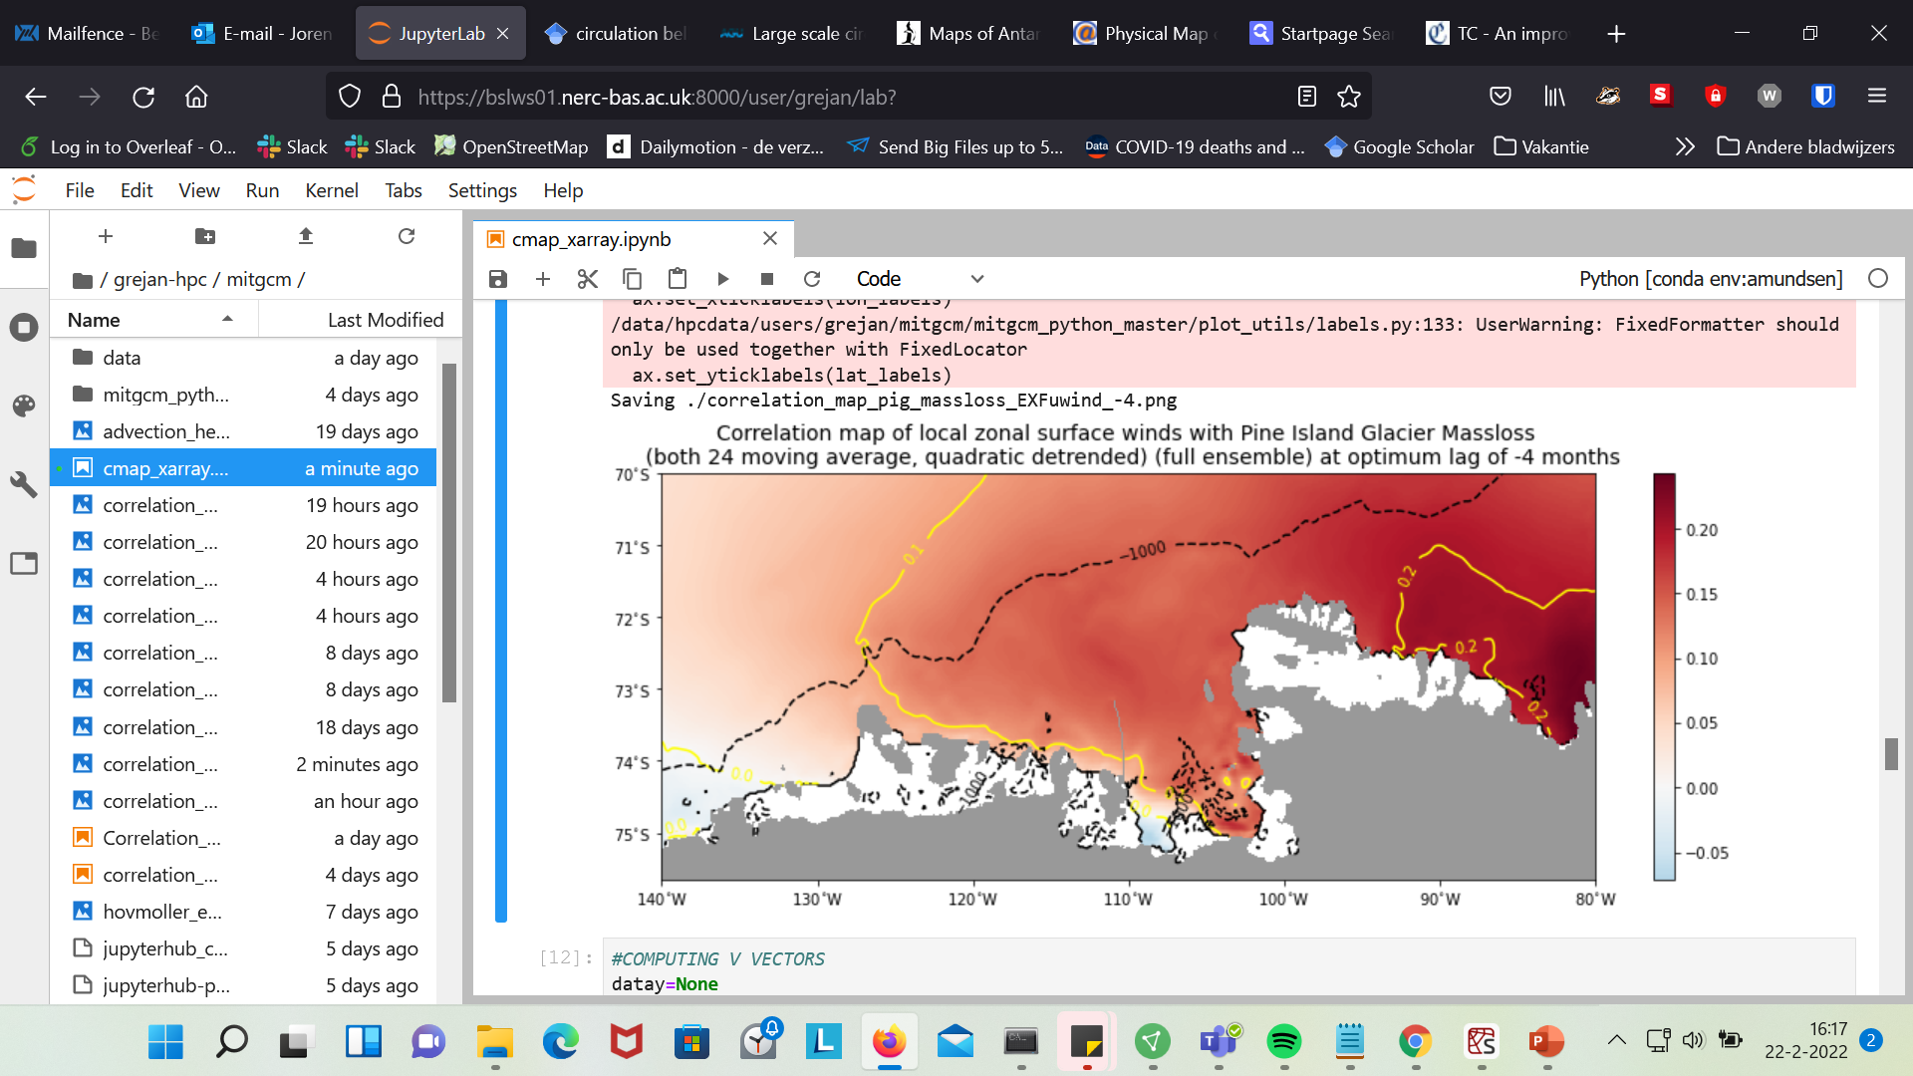
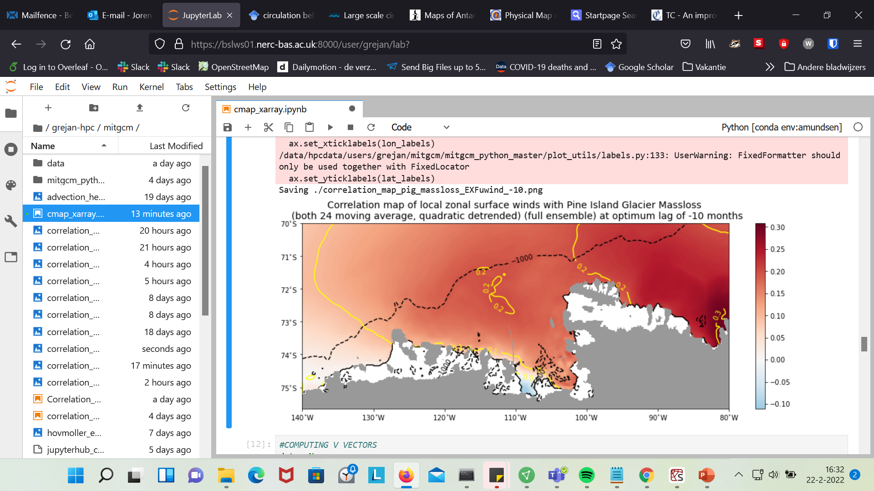
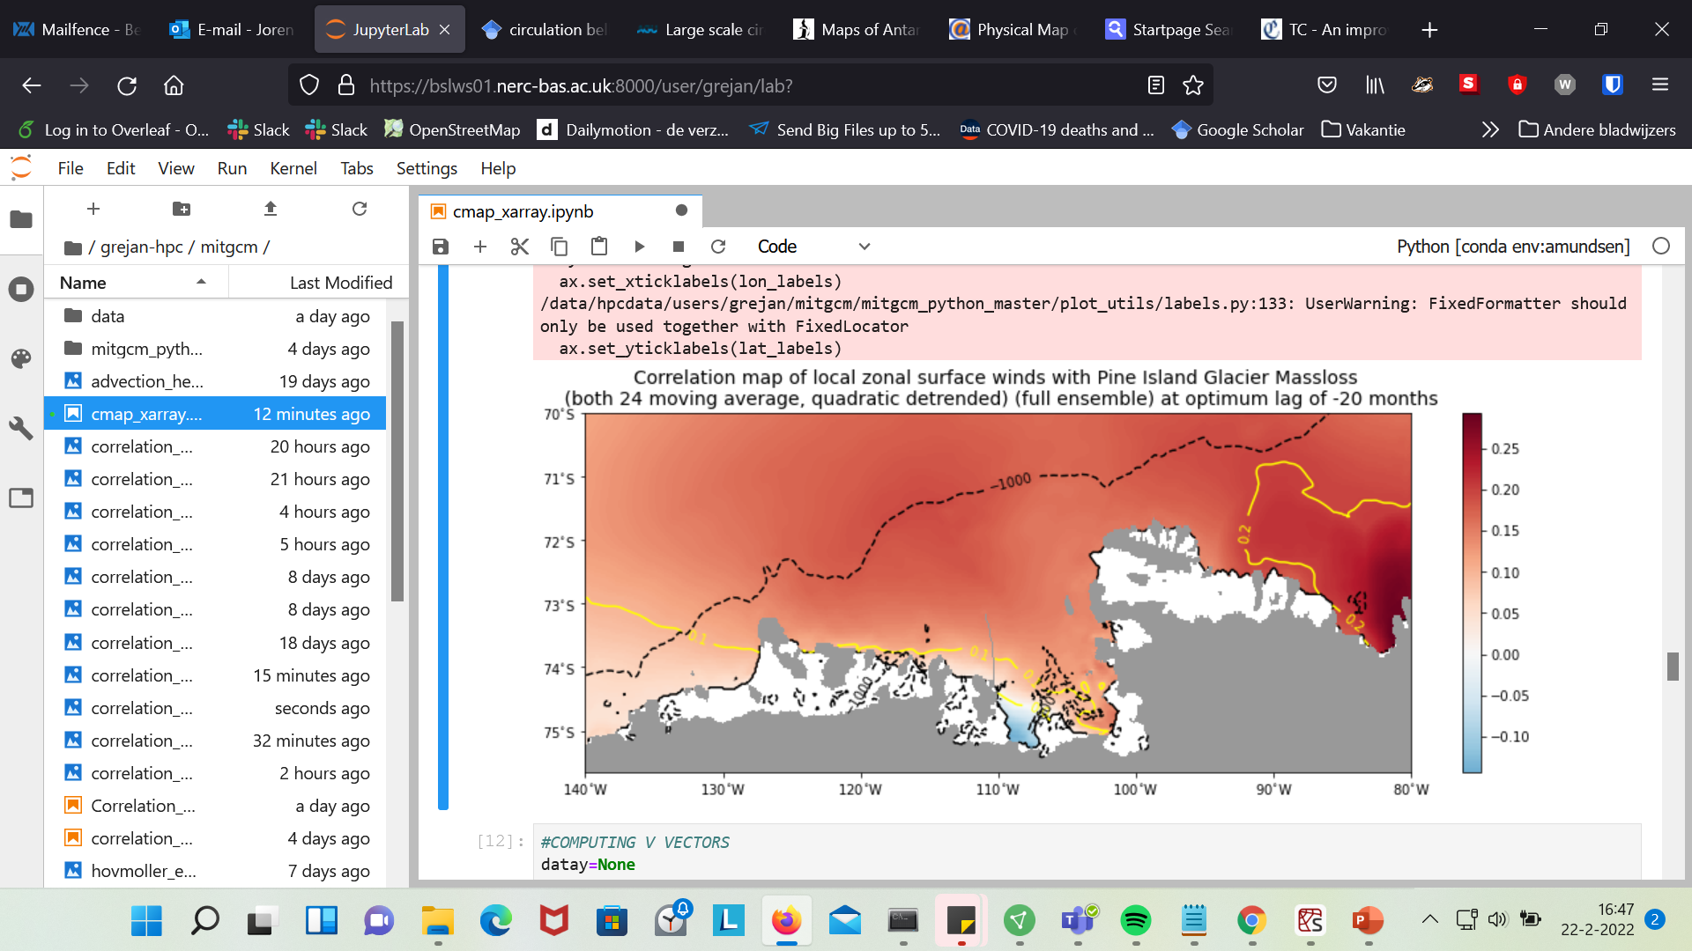

Slide 12
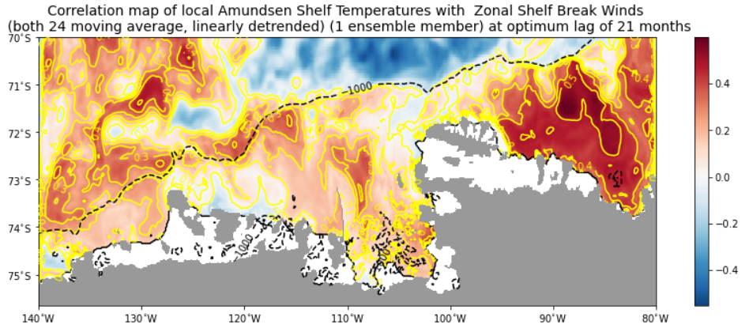
quadratically
Preliminary try with first 1 ensemble member

Slide 13
Summary
The location of shelf break wind box does correspond with a local optimum in winds and seems to correlate with conditions on the shelf.
But there is very strong correlation in Bellinghausen Sea. Why?
Slight negative correlation close to the ice front in PIB. → Sea ice formation?
Lags are very large? Maybe due to looking at longer time scales? But still…

Slide 14
Kimura et al., 2017
The positive zonal wind stress and negative wind stress curl over the PITW and PITE troughs in austral winter correspond to the timing of positive onshore heat transport in the PITE trough (Figure 6b). The largest melting of PIG and Thwaites in September–November is a few months after the peaks in the zonal wind signal…

Slide 15
Next
More ensemble members
Double check with original method of Kaitlin.

Slide 16
First Glance at CESM2

Slide 17
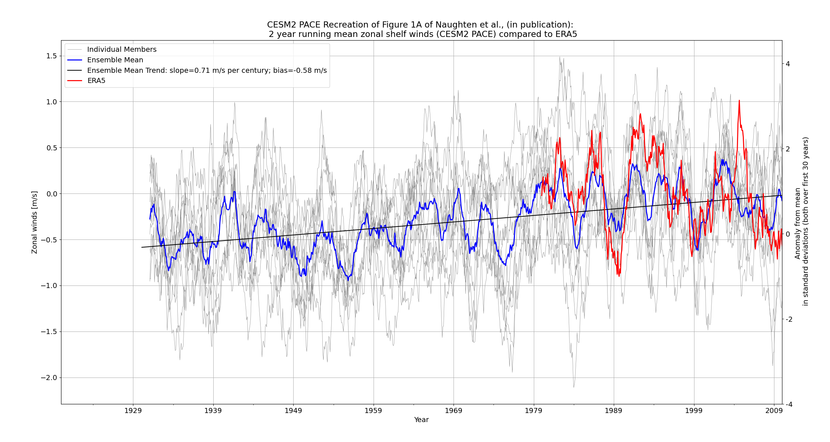

Slide 18
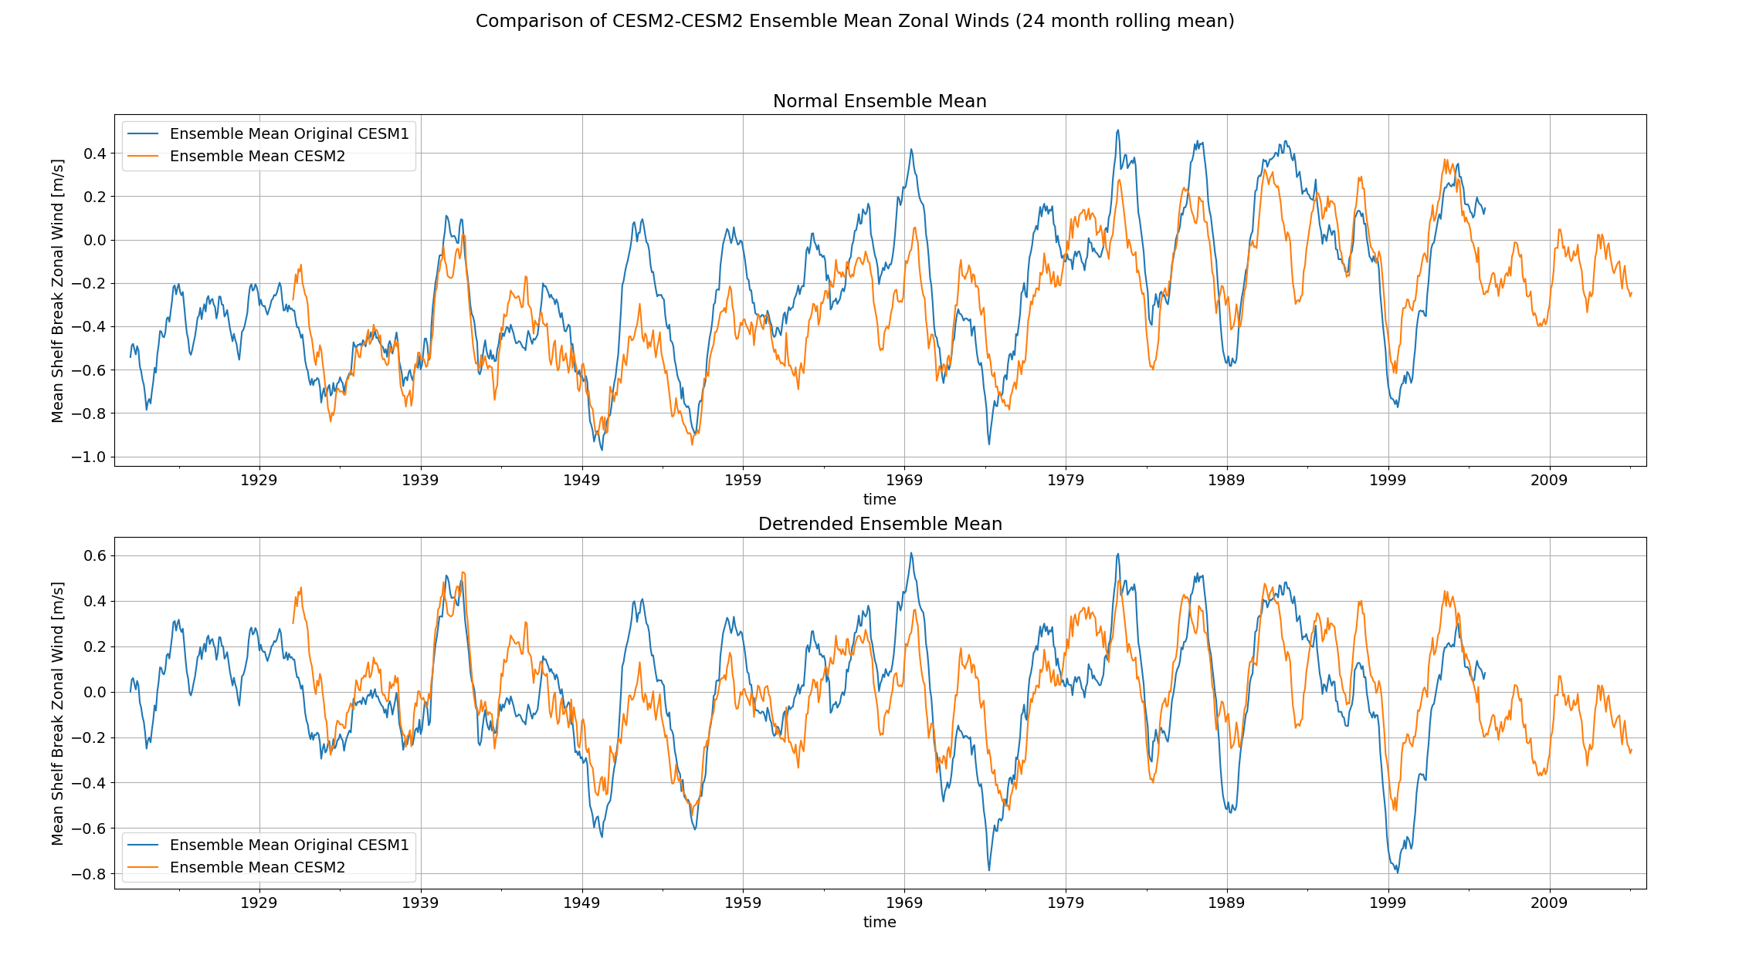

Slide 19
Summary
1940s peak in shelf break winds remains the same, but other peaks are reduced.

Slide 20
What wind conditions are common for warm periods? And what is different for the 1940s?

Slide 21
Summary of last time
Ensemble mean melt seems to be related to longer term (decade) shelf wind and ONI forcing.
High peaks in melt therefore depend on period before.
1940s ENSO is strong, but the ENSO events surrounding it are weak, ergo: weaker melt…

Slide 22
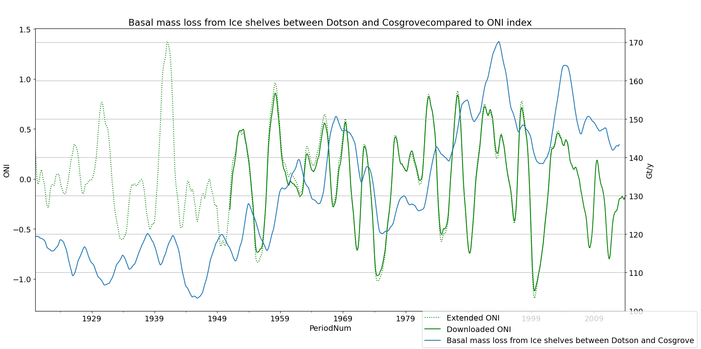
Summary of last time

Slide 23
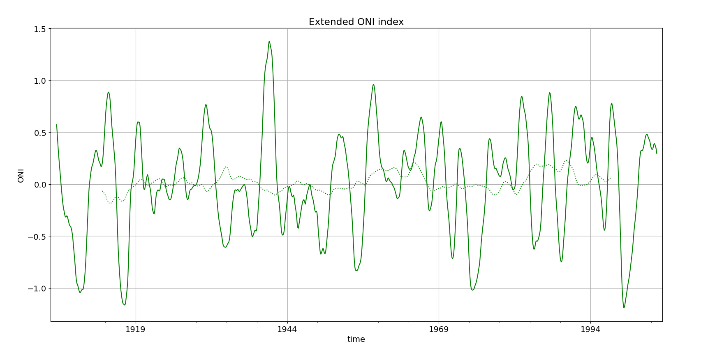
Summary of last time

Slide 24
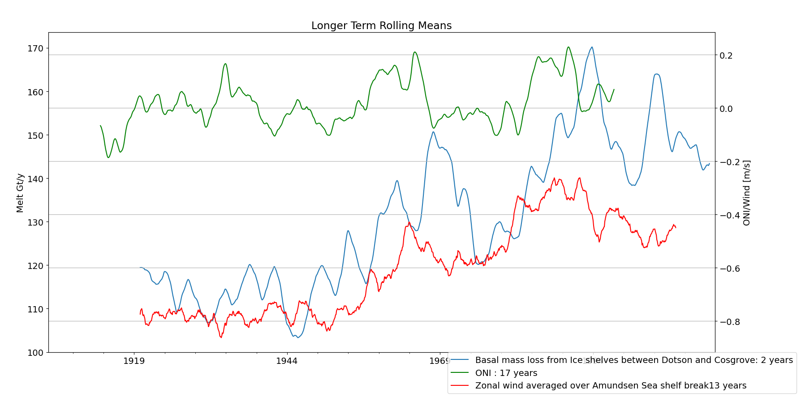
Summary of last time

Slide 25
Tasks
Organise code
Prepare for meeting with Eric and Gemma

Slide 28
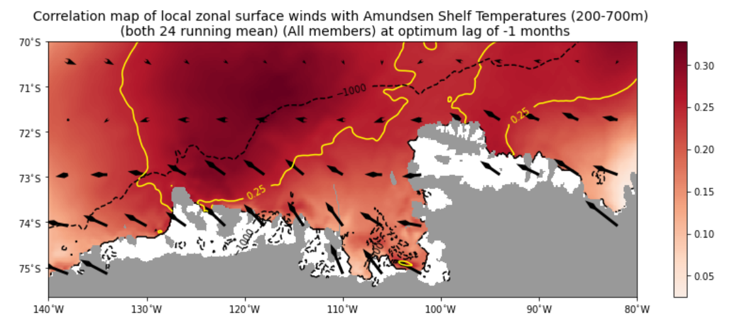
Only 1 member

Slide 29
